Slide 1
Stewardship 3.0
Presented by Katie Price
Archdiocese of Chicago
Parish Stewardship Coordinator

Slide 2
Welcome & Agenda
The Basics: Food, Beverage, Nametags, Restrooms
Introduce Sponsor- Thank You Faith Direct!
What Is Stewardship 3.0?
Why
Discussion/ Exercise
How We Are Going to Get It Done
Open Discussion & FAQs

Slide 3
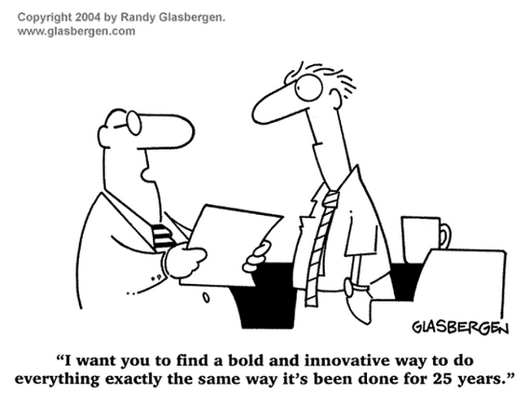

Slide 4
Strive to be faithful
not successful.

Slide 5
Stewardship 1.0
The Tithe
Tithing is returning 10% of your blessings to God
OT- Sacrifice seen as a reminder that all is owed to God- people were dependent on God’s creation very clearly as it sustained their life.
NT- Jesus called us to more than the OT tithe, but to give up everything and follow Him.
Did she say “tithing?”
Yes, yes I did.
http://archstl.org/stewardship/page/faqs-about-tithing

Slide 6
Stewardship 2.0
The Modern Tithe
Witness an increase in digital demand
Challenge of understanding the word “stewardship” and why
Time, Talent, and Treasure is discussed, but focus is on treasure
Idea that lots of activities or ministries must mean successful stewardship
Everyone fits into a one-size fits all “stewardship box”
I give online, I’m good.
I don’t understand.
Another appeal?

Slide 7
Stewardship 3.0
Forming Disciples
A paradigm shift in thinking:
From maintenance mode... to mission mode
From we need to do this...to just think what we can do
From taking a collection...to everyone offering a gift
Creating a new normal for a stewardship way of life

Slide 8
“Once one chooses to become a disciple of Jesus Christ, stewardship is not an option.”
~Bishop John McRaith

Slide 9
Restaurant Hospitality.
What did they do when you arrived?
How did you know where to sit? What if it was full?
How did you know what to get or what was special about the place?
What if your little one needed a restroom? Or help with a question?
What about the ambiance, the music, the staff, the meal that was shared?
If it cost nothing or if money is no issue, would you want to come back?
What if I asked these same questions about your Parish on Sunday?

Slide 10
Stewardship begins with hospitality.
Sunday hospitality.
~Stewardship 3.0

Slide 11
Stewardship 3.0
They are givers and receivers
Passionate about Sunday
Radically obsessed with invitation and participation
Give witness to the Gospel through actions
They receive and engage seekers and searchers
What does a Stewardship 3.0 Pastor, staff, or parishioner
look like?

Slide 12
How does a Stewardship 3.0 Parish
plan and act?
Leadership (Discipleship) Formation and Education
Radically Obsessed with Invitation and Participation
They Plan for Sundays
They Create and Nurture a Sense of Welcome
They Provide a Comprehensive Approach to the Offertory

Slide 13
Why
Stewardship 3.0?
Stewardship is alive when the spirit of discipleship moves through our hearts into the heart of another via our words and actions
Stewardship is moving beyond informing to transforming
At the heart of stewardship, we are answering Jesus’ call to us...
Isn’t that worthy of everything we have?
We often overlook the “why” but in this question we find value and meaning behind our Mission.

Slide 14
What version is your Parish operating?

Slide 15
How to we avoid the C.A.V.E’s?
“Consistently Against Virtually Everything” Types

Slide 16
What are the barriers?
But we have to talk about money.
We need quick solutions to fix our problems
Financial Stewardship will fix our problems
We don’t have the time or staff
Are you saying we don’t do the offertory anymore?
We all have challenges, no matter our role in the community- Pastoral staff, business staff, parishioners, or newcomers

Slide 17
Great stuff, Katie
But, really, how do we do it all?

Slide 18
Stewardship Committee 101
Successful Stewardship Committees
Diverse
Succession Planners
Offer Formation Programs
Offer Recognition
Create Communications
Provide Hospitality/Welcome
Collect Data/Staff Coordination
If one of the Apostles wouldn’t apply, we might be doing it wrong.

Slide 19
Part I: Sustainable Stewardship
Stewardship 3.0 only thrives in a community when the experience is sustainable.
What does sustainable stewardship mean?
The Parishioners are well versed in stewardship meaning and opportunity
The Pastor shares responsibility for stewardship messaging and experience with the Parishioners, but the burden of stewardship does NOT rests on the Pastor
The Archdiocese staff is a part of your team

Slide 20
Part II: Sustainable Stewardship
There are 3 Steps to Sustainable Stewardship
Step 1: Create Leadership Formation opportunities
Step 2: Create the infrastructure and capacity for doing stewardship at your Parish
Step 3: Create a culture of stewardship by constant content development and delivery

Slide 21
Step 1
Archdiocesan workshops, webinars, and website have great tools for training
Leader networking, small Deanery groups or online networking opportunities
Stewardship Celebration Day
Host a Stewardship Evening of Discussion or Retreat
Create Leadership formation opportunities for all audiences, Pastors, staff, and parishioners

Slide 22
Step 2
The motto this year is: finding time, where time doesn’t exist
Archdiocese putting into place a system of resources to provide the capacity and infrastructure to succeed.
Attend webinars offering marketing and messaging assistance
Practice asking for things.
Create the infrastructure and capacity for doing stewardship at your Parish

Slide 23
Step 3
Check out the website for updated content
The Spirit of Stewardship E-Newsletter always has new content to utilize in bulletins or the website
Experiment with ideas, for example
Stories of Stewardship
Stewardship Sunday
Create a culture of stewardship by constant content development and delivery

Slide 24
Planned Offertory Program (POP)
POP a.k.a the Planned Offertory Program was developed to dedicate a time of year to understanding stewardship, asking for a stewardship commitment of time, talent, and treasure, over the next year, and formalized the giving process for a Parish.
Traditionally the Archdiocese assisted with:
Form letters for mailing parishioners
Educated parishes on the program’s 3-weekend approach
Provided commitment cards for the planned stewardship gift
Witness talks and other documents were found on the website
In-person/phone consulting

Slide 25
What is new?
Previous POP
Form letter mailings
Testimonies
No theme or design
Parish responsible for most of the work
New POP
Mailings and/or email marketing
Testimonies in person AND video
Theme and graphic design
Archdiocese completed most of the work
Analysis and case studies shared

Slide 26
What is the Archdiocese providing for your use?
Theme Development
5 graphics for web or print (based on theme and template choice)
Segmented audience outlines (Pilot Program includes Mailchimp/email assistance)
1 Parish Video Template
4 Social Media Posts
*Training on tools to create your own campaign offered in September/October
*Theme packages and design files will be posted on website in September

Slide 27
Want to see one?
Consider it done.

Slide 28
Theme #1: Living Discipleship Through Spirit, Gifts, and Service.

Slide 31
http://video214.com/play/2cm1zKaIaBmMf2TeoOiWeA/s/dark

Slide 32
How do I participate?
Join the Pilot Program!
We will work closely with you on all materials and set-up
Check out the website for themes, letter outlines, timelines etc.
Contact Katie by September 15th with your questions or interest.
We will be starting the roll-out of the campaign the weekend of October 8th or the 15th, depending on the Parish.
Two options

Slide 33
How does all this compliment the Renew My Church effort?

Slide 34
Let’s ask some questions and discuss!

